Slide 1
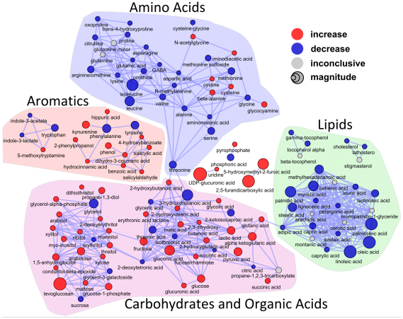
Identification of altered biochemical domains between pumpkin and tomatillo leaf metabolites
Use DATA: Pathway Enrichment data.csv
Goal: Identify significantly over represented biological pathways based on significant differences in leaf metabolites
Topics:
KEGG Database
MetaboAnalyst: Pathway enrichment analysis
MBrole: Over Representation Analysis
Hypergeometric test for enrichment
Biochemical Enrichment Analysis

Slide 2
KEGG Pathway Visualization
Goals:
Use KEGG to:
Overview glutamate entry in KEGG (C00025)
Visualize a pathway of interest
Map metabolite of interest to pathway
http://www.kegg.jp/dbget-bin/www_bget?C00025
http://www.kegg.jp/kegg-bin/show_pathway?org_name=ath&mapno=00250
Mapping example
C00064 green, black
C00025 green, black
Biochemical Enrichment Analysis

Slide 3

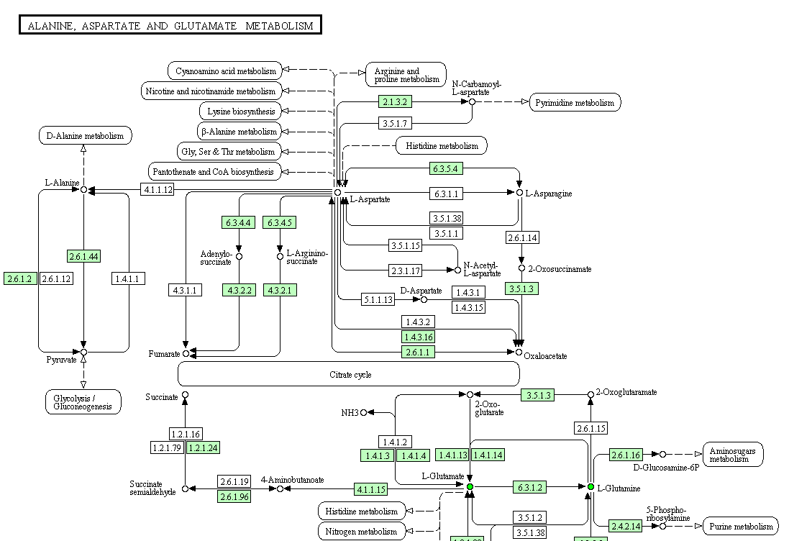
Pathway Visualization
Biochemical Enrichment Analysis

Slide 4

Pathway over representation analysis (ORA)
Steps:
1. Use MBrole to conduct:
Pathway over representation analysis
url: http://csbg.cnb.csic.es/mbrole/
ORA:
is used to evaluate whether a particular set of metabolites is represented more than expected by chance within a given compound list [doi: 10.1093/nar/gkq329].
p-value is calculated using hypergeometric or Fisher’s exact test
Biochemical Enrichment Analysis

Slide 5
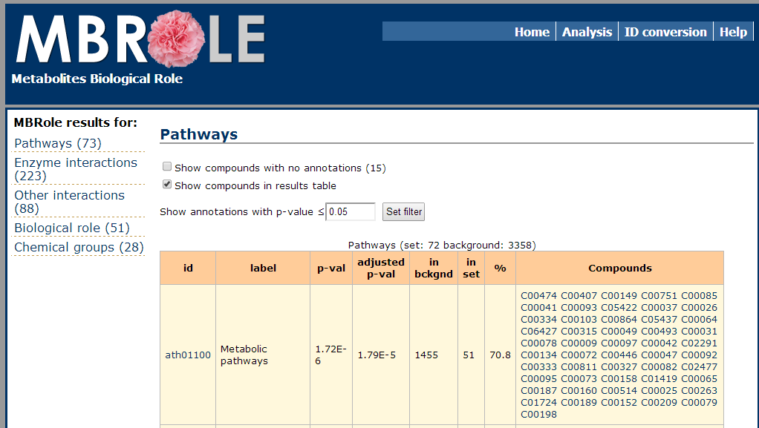
MBRole:
Pathway Over Representation
Analysis (ORA)
Goal: Identify an over represented pathway and visualize it in KEGG
Biochemical Enrichment Analysis

Slide 6
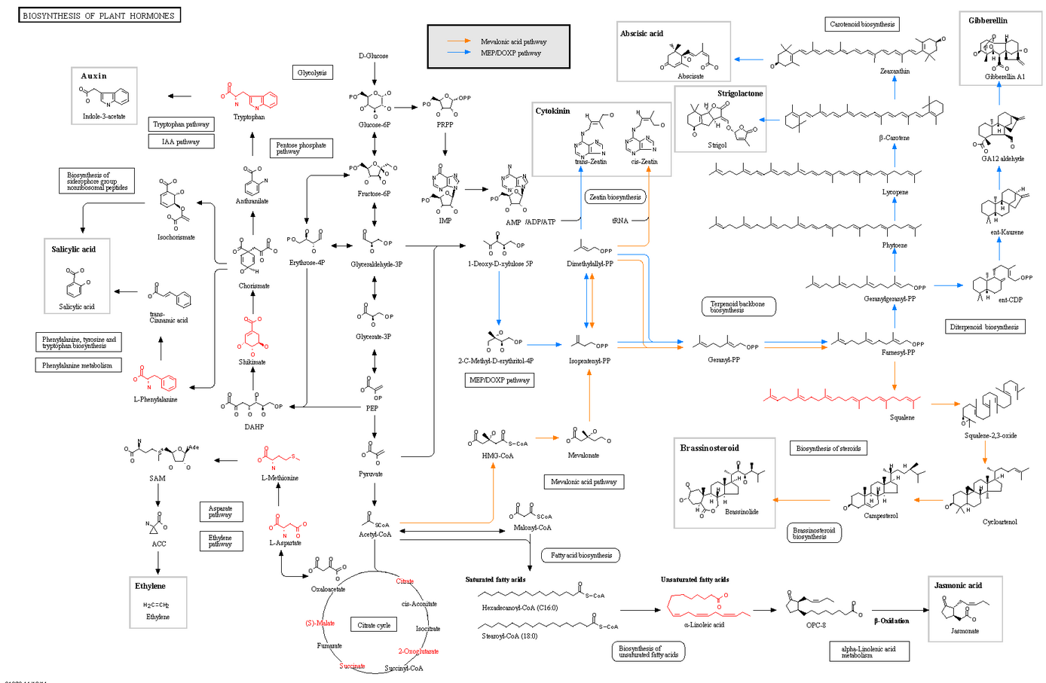
MBRole
Biochemical Enrichment Analysis
http://www.genome.jp/kegg-bin/show_pathway?map01070+C06427+C00158+C00049+C00493+C00079+C00026+C00042+C00751+C00149+C00078+C00073+

Slide 7
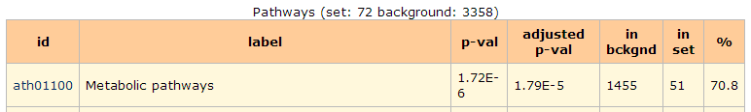
Test for significance:
Hypergeometric Test
How to calculate statistics to determine network enrichment?
hit.num = 51 # number of significantly changed pathway metabolites
set.num = 1455 # number of metabolites in pathway
full = 3358 # all possible metabolites in organism
q.size = 72 # number of significantly changed metabolites
phyper(hit.num-1, set.num, full-set.num, q.size, lower.tail=F)
= 1.717553e-06
Biochemical Enrichment Analysis

Slide 8
MetaboAnalyst:
Pathway Enrichment Analysis
(PEA)
Use MetaboAnalyst to conduct:
Pathway enrichment Analysis
url: http://www.metaboanalyst.ca/MetaboAnalyst/faces/UploadView.jsp
PEA:
is an advanced form of over representation analysis (ORA) which takes into account pathway topology and is based on gene set enrichment analysis (GSEA) [doi:10.1093/bioinformatics/btq418]
p-value is calculated using hypergeometric or Fisher’s exact test
Questions:
What pathway is the most important based on ORA and topology?
Biochemical Enrichment Analysis

Slide 9
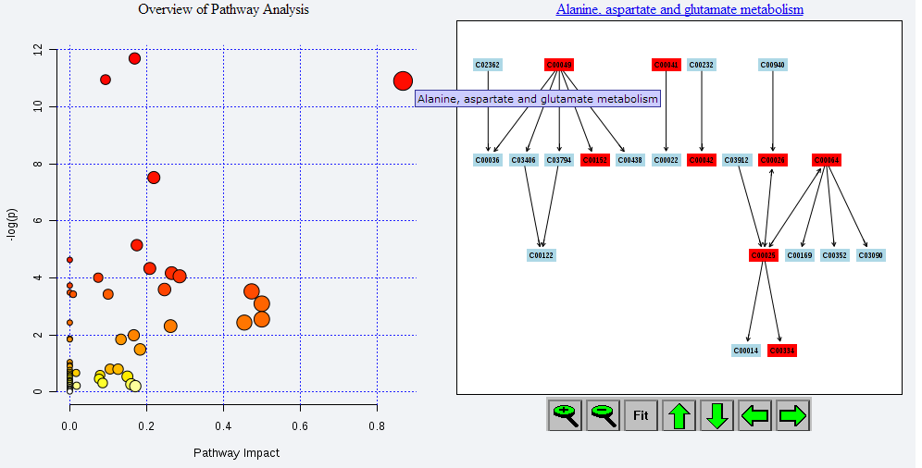
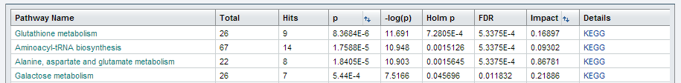
KEGG Pathway Enrichment
Biochemical Enrichment Analysis

Slide 10
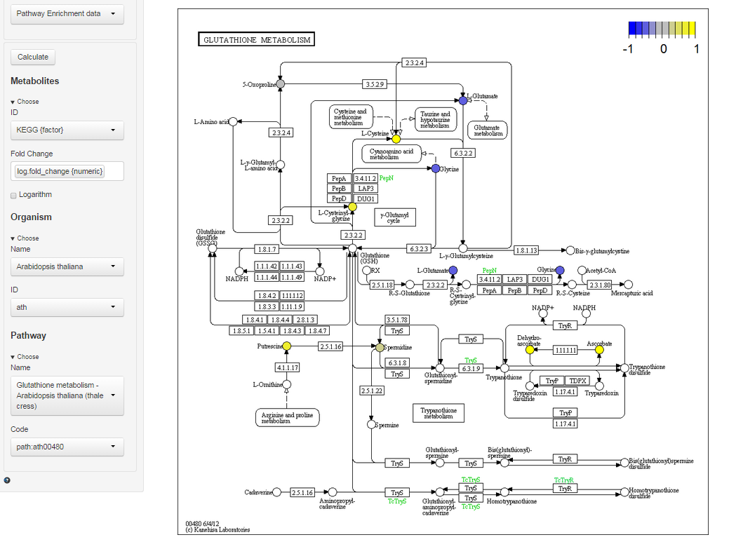
Visualize changes in metabolites for a pathway/organism of interest
PathViewR
increased or decreased in tomatillo vs. pumpkin
Biochemical Enrichment Analysis

